Slide 1
Operating System Presentation
Prepared By Sumon Karmakar

Slide 2
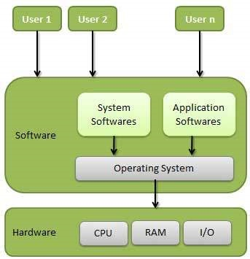
Operating System Presentation
Definition:- An operating system is a program that acts as an interface between the user and the computer hardware and controls the execution of all kinds of programs.

Slide 3
Operating System Presentation
Important function of an operating system:- These are some important functions that are performed by operating system.
Memory Management
Processor Management
Device Management
File Management
Security
Control over system performance
Job accounting
Error detecting aids
Coordination between other software and users

Slide 4
Operating System Presentation
Types of Operating System:- There are different types of Operating System. They are as follows:
Batch Operating System
Time Sharing Operating System
Distribute Operating System
Network Operating System
Real Time Operating System

Slide 5
Operating System Presentation
Types of Operating System:-
Batch Operating System:- The users of a batch operating system do not interact with the computer directly. Each user prepares his job on an off-line device like punch cards and submits it to the computer operator. To speed up processing, jobs with similar needs are batched together and run as a group. The programmers leave their programs with the operator and the operator then sorts the programs with similar requirements into batches.
The problems with Batch Systems are as follows −
Lack of interaction between the user and the job.
CPU is often idle, because the speed of the mechanical I/O devices is slower than the CPU.
Difficult to provide the desired priority.

Slide 6
Operating System Presentation
Types of Operating System:-
Time Sharing Operating System:- Time-sharing is a technique which enables many people, located at various terminals, to use a particular computer system at the same time. Time-sharing or multitasking is a logical extension of multiprogramming. Processor's time which is shared among multiple users simultaneously is termed as time-sharing.
The main difference between Multiprogrammed Batch Systems and Time-Sharing Systems is that in case of Multiprogrammed batch systems, the objective is to maximize processor use, whereas in Time-Sharing Systems, the objective is to minimize response time.

Slide 7
Operating System Presentation
Types of Operating System:-
Advantages of Time Sharing Operating System:-
Provides the advantage of quick response.
Avoids duplication of software.
Reduces CPU idle time.
Disadvantages of Time Sharing Operating System:-
Problem of reliability.
Question of security and integrity of user programs and data.
Problem of data communication.

Slide 8
Operating System Presentation
Types of Operating System:-
Distributed Operating System:- Distributed systems use multiple central processors to serve multiple real-time applications and multiple users. Data processing jobs are distributed among the processors accordingly.
Advantages:-With resource sharing facility, a user at one site may be able to use the resources available at another.
Speedup the exchange of data with one another via electronic mail.
If one site fails in a distributed system, the remaining sites can potentially continue operating.
Better service to the customers.
Reduction of the load on the host computer.
Reduction of delays in data processing.

Slide 9
Operating System Presentation
Types of Operating System:-
Network Operating System:- A Network Operating System runs on a server and provides the server the capability to manage data, users, groups, security, applications, and other networking functions. The primary purpose of the network operating system is to allow shared file and printer access among multiple computers in a network, typically a local area network (LAN), a private network or to other networks.

Slide 10
Operating System Presentation
Types of Operating System:-
Advantages of Network Operating System:-
Centralized servers are highly stable.
Security is server managed.
Upgrades to new technologies and hardware can be easily integrated into the system.
Remote access to servers is possible from different locations and types of systems.
Disadvantages of Network Operating System:-
High cost of buying and running a server.
Dependency on a central location for most operations.
Regular maintenance and updates are required.

Slide 11
Operating System Presentation
Types of Operating System:-
Real Time Operating System:- A real-time system is defined as a data processing system in which the time interval required to process and respond to inputs is so small that it controls the environment. The time taken by the system to respond to an input and display of required updated information is termed as the response time. So in this method, the response time is very less as compared to online processing.

Slide 12
Operating System Presentation
Services performed by Operating System:-
An Operating System provides services to both the users and to the programs.
It provides programs an environment to execute.
It provides users the services to execute the programs in a convenient manner.
Following are a few common services provided by an operating system −
Program execution
I/O operations
File System manipulation
Communication
Error Detection
Resource Allocation
Protection

Slide 13
Operating System Presentation
Batch Processing:-
Batch processing is a technique in which an Operating System collects the programs and data together in a batch before processing starts. An operating system does the following activities related to batch processing −
The OS defines a job which has predefined sequence of commands, programs and data as a single unit.
The OS keeps a number a jobs in memory and executes them without any manual information.
Jobs are processed in the order of submission, i.e., first come first served fashion.
When a job completes its execution, its memory is released and the output for the job gets copied into an output spool for later printing or processing.

Slide 14
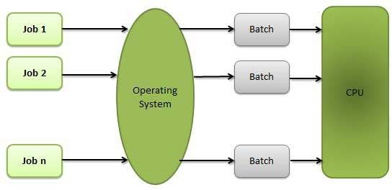
Operating System Presentation
Batch Processing:-

Slide 15
Operating System Presentation
Batch Processing:-
Advantages:-
Batch processing takes much of the work of the operator to the computer.
Increased performance as a new job get started as soon as the previous job is finished, without any manual intervention.
Disadvantages:-
Difficult to debug program.
A job could enter an infinite loop.
Due to lack of protection scheme, one batch job can affect pending jobs.

Slide 16
Operating System Presentation
Multitasking:- Multitasking is when multiple jobs are executed by the CPU simultaneously by switching between them. Switches occur so frequently that the users may interact with each program while it is running. An OS does the following activities related to multitasking −
The user gives instructions to the operating system or to a program directly, and receives an immediate response.
The OS handles multitasking in the way that it can handle multiple operations/executes multiple programs at a time.
Multitasking Operating Systems are also known as Time-sharing systems.
These Operating Systems were developed to provide interactive use of a computer system at a reasonable cost.
A time-shared operating system uses the concept of CPU scheduling and multiprogramming to provide each user with a small portion of a time-shared CPU.
Each user has at least one separate program in memory.

Slide 17
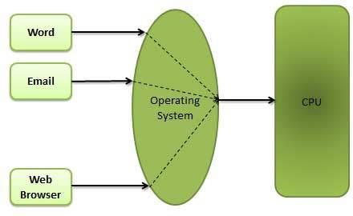
Operating System Presentation
Multitasking:-

Slide 18
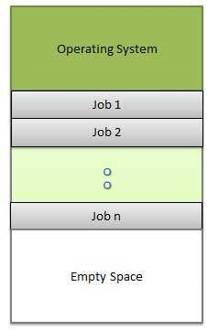
Operating System Presentation
Multiprogramming:- Sharing the processor, when two or more programs reside in memory at the same time, is referred as multiprogramming. Multiprogramming assumes a single shared processor. Multiprogramming increases CPU utilization by organizing jobs so that the CPU always has one to execute.

Slide 19
Operating System Presentation
Multiprogramming:-
Advantages
High and efficient CPU utilization.
User feels that many programs are allotted CPU almost simultaneously.
Disadvantages
CPU scheduling is required.
To accommodate many jobs in memory, memory management is required.

Slide 20
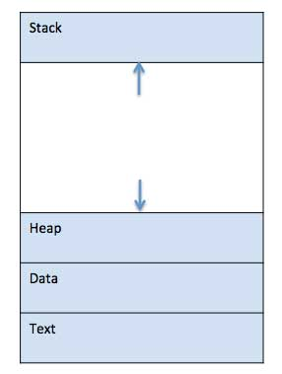
Operating System Presentation
Process:- A process is basically a program in execution. The execution of a process must progress in a sequential fashion.
A process is defined as an entity which represents the basic unit of work to be implemented in the system.

Slide 21
Operating System Presentation
Process life cycle:- When a process executes, it passes through different states. These stages may differ in different operating systems, and the names of these states are also not standardized.

Slide 22
Operating System Presentation
Process life cycle:-
S.N. | State & Description
1 | Start This is the initial state when a process is first started/created.
2 | Ready The process is waiting to be assigned to a processor. Ready processes are waiting to have the processor allocated to them by the operating system so that they can run. Process may come into this state after Start state or while running it by but interrupted by the scheduler to assign CPU to some other process.
3 | Running Once the process has been assigned to a processor by the OS scheduler, the process state is set to running and the processor executes its instructions.
4 | Waiting Process moves into the waiting state if it needs to wait for a resource, such as waiting for user input, or waiting for a file to become available.
5 | Terminated or Exit Once the process finishes its execution, or it is terminated by the operating system, it is moved to the terminated state where it waits to be removed from main memory.

Slide 23
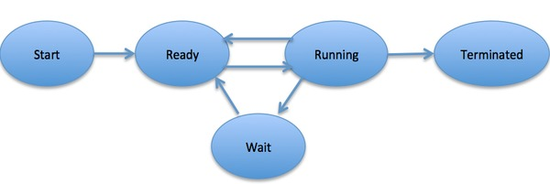
Operating System Presentation
Process life cycle:-

Slide 24
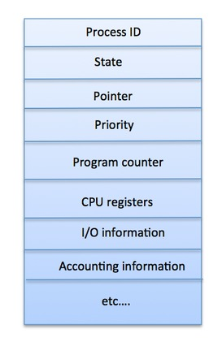
Operating System Presentation
Process Control Block(PCB):- A Process Control Block is a data structure maintained by the Operating System for every process. The PCB is identified by an integer process ID (PID).

Slide 25
Operating System Presentation
Process Scheduling Queues:-
Definition:- The process scheduling is the activity of the process manager that handles the removal of the running process from the CPU and the selection of another process on the basis of a particular strategy.
The Operating System maintains the following important process scheduling queues −
Job queue − This queue keeps all the processes in the system.
Ready queue − This queue keeps a set of all processes residing in main memory, ready and waiting to execute. A new process is always put in this queue.
Device queues − The processes which are blocked due to unavailability of an I/O device constitute this queue.

Slide 26
Operating System Presentation
Process Scheduling Queues:-
The OS maintains all PCBs in Process Scheduling Queues. The OS maintains a separate queue for each of the process states and PCBs of all processes in the same execution state are placed in the same queue. When the state of a process is changed, its PCB is unlinked from its current queue and moved to its new state queue.

Slide 27
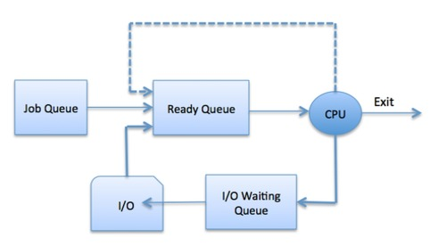
Operating System Presentation
Process Scheduling Queues:- The Operating System maintains the following important process scheduling queues −
Job queue − This queue keeps all the processes in the system.
Ready queue − This queue keeps a set of all processes residing in main memory, ready and waiting to execute. A new process is always put in this queue.
Device queues − The processes which are blocked due to unavailability of an I/O device constitute this queue.

Slide 28
Operating System Presentation
Two State Process Model:-
S.N. | State & Description
1 | Running When a new process is created, it enters into the system as in the running state.
2 | Not Running Processes that are not running are kept in queue, waiting for their turn to execute. Each entry in the queue is a pointer to a particular process. Queue is implemented by using linked list. Use of dispatcher is as follows. When a process is interrupted, that process is transferred in the waiting queue. If the process has completed or aborted, the process is discarded. In either case, the dispatcher then selects a process from the queue to execute.

Slide 29
Operating System Presentation
Schedulers:- Schedulers are special system software which handle process scheduling in various ways. Their main task is to select the jobs to be submitted into the system and to decide which process to run. Schedulers are of three types −
Long-Term Scheduler
Short-Term Scheduler
Medium-Term Scheduler

Slide 30
Operating System Presentation
Long-Term Schedulers:- It is also called a job scheduler. A long-term scheduler determines which programs are admitted to the system for processing. It selects processes from the queue and loads them into memory for execution. Process loads into the memory for CPU scheduling.
The primary objective of the job scheduler is to provide a balanced mix of jobs, such as I/O bound and processor bound. It also controls the degree of multiprogramming. If the degree of multiprogramming is stable, then the average rate of process creation must be equal to the average departure rate of processes leaving the system.
On some systems, the long-term scheduler may not be available or minimal. Time-sharing operating systems have no long term scheduler. When a process changes the state from new to ready, then there is use of long-term scheduler.

Slide 31
Operating System Presentation
Short-Term Schedulers:- It is also called as CPU scheduler. Its main objective is to increase system performance in accordance with the chosen set of criteria. It is the change of ready state to running state of the process. CPU scheduler selects a process among the processes that are ready to execute and allocates CPU to one of them.
Short-term schedulers, also known as dispatchers, make the decision of which process to execute next. Short-term schedulers are faster than long-term schedulers.

Slide 32
Operating System Presentation
Medium-Term Schedulers:- Medium-term scheduling is a part of swapping. It removes the processes from the memory. It reduces the degree of multiprogramming. The medium-term scheduler is in-charge of handling the swapped out-processes.
A running process may become suspended if it makes an I/O request. A suspended processes cannot make any progress towards completion. In this condition, to remove the process from memory and make space for other processes, the suspended process is moved to the secondary storage. This process is called swapping, and the process is said to be swapped out or rolled out. Swapping may be necessary to improve the process mix.

Slide 33
Operating System Presentation
Context Switch:- A context switch is the mechanism to store and restore the state or context of a CPU in Process Control block so that a process execution can be resumed from the same point at a later time. Using this technique, a context switcher enables multiple processes to share a single CPU. Context switching is an essential part of a multitasking operating system features.
When the scheduler switches the CPU from executing one process to execute another, the state from the current running process is stored into the process control block. After this, the state for the process to run next is loaded from its own PCB and used to set the PC, registers, etc. At that point, the second process can start executing.

Slide 34
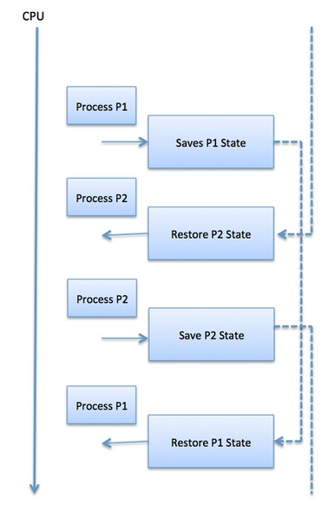
Operating System Presentation
Context Switch:-

Slide 35
Operating System Presentation
Operating System Scheduling Algorithm:- A Process Scheduler schedules different processes to be assigned to the CPU based on particular scheduling algorithms. There are six popular process scheduling algorithms which we are going to discuss in this chapter −
First-Come, First-Served (FCFS) Scheduling
Shortest-Job-Next (SJN) Scheduling
Priority Scheduling
Shortest Remaining Time
Round Robin(RR) Scheduling
Multiple-Level Queues Scheduling

Slide 36
Operating System Presentation
Operating System Scheduling Algorithm:-
First-Come, First-Served (FCFS) Scheduling:-
Jobs are executed on first come, first serve basis.
It is a non-preemptive, pre-emptive scheduling algorithm.
Easy to understand and implement.
Its implementation is based on FIFO queue.
Poor in performance as average wait time is high.

Slide 37
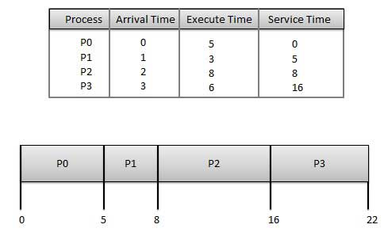
Operating System Presentation
Operating System Scheduling Algorithm:-
First-Come, First-Served (FCFS) Scheduling:-

Slide 38
Operating System Presentation
Operating System Scheduling Algorithm:-
First-Come, First-Served (FCFS) Scheduling:- Wait time of each process is as follows −
Average Wait Time: (0+4+6+13) / 4 = 5.75
Process | Wait Time : Service Time - Arrival Time
P0 | 0 - 0 = 0
P1 | 5 - 1 = 4
P2 | 8 - 2 = 6
P3 | 16 - 3 = 13

Slide 39
Operating System Presentation
Operating System Scheduling Algorithm:-
Shortest Job Next (SJN) Scheduling:- This is also known as shortest job first, or SJF
This is a non-preemptive, pre-emptive scheduling algorithm.
Best approach to minimize waiting time.
Easy to implement in Batch systems where required CPU time is known in advance.
Impossible to implement in interactive systems where required CPU time is not known.
The processer should know in advance how much time process will take.

Slide 40
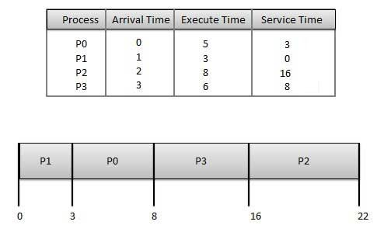
Operating System Presentation
Operating System Scheduling Algorithm:-
Shortest Job Next (SJN) Scheduling:-

Slide 41
Operating System Presentation
Operating System Scheduling Algorithm:-
Shortest Job Next (SJN) Scheduling:- Wait time of each process is as follows −
Process | Wait Time : Service Time - Arrival Time
P0 | 3 - 0 = 3
P1 | 0 - 0 = 0
P2 | 16 - 2 = 14
P3 | 8 - 3 = 5
Average Wait Time: (3+0+14+5) / 4 = 5.50

Slide 42
Operating System Presentation
Operating System Scheduling Algorithm:-
Priority Based Scheduling:- Priority scheduling is a non-preemptive algorithm and one of the most common scheduling algorithms in batch systems.
Each process is assigned a priority. Process with highest priority is to be executed first and so on.
Processes with same priority are executed on first come first served basis.
Priority can be decided based on memory requirements, time requirements or any other resource requirement.

Slide 43
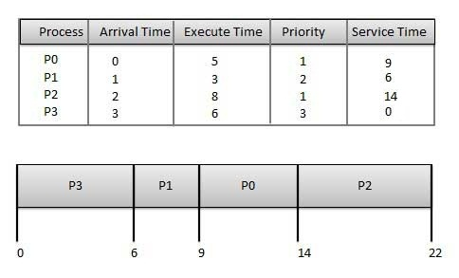
Operating System Presentation
Operating System Scheduling Algorithm:-
Priority Based Scheduling:-

Slide 44
Operating System Presentation
Operating System Scheduling Algorithm:-
Priority Based Scheduling:- Wait time of each process is as follows −
Average Wait Time: (9+5+12+0) / 4 = 6.5
Process | Wait Time : Service Time - Arrival Time
P0 | 9 - 0 = 9
P1 | 6 - 1 = 5
P2 | 14 - 2 = 12
P3 | 0 - 0 = 0

Slide 45
Operating System Presentation
Operating System Scheduling Algorithm:-
Shortest Remaining Time:-
Shortest remaining time (SRT) is the preemptive version of the SJN algorithm.
The processor is allocated to the job closest to completion but it can be preempted by a newer ready job with shorter time to completion.
Impossible to implement in interactive systems where required CPU time is not known.
It is often used in batch environments where short jobs need to give preference.

Slide 46
Operating System Presentation
Operating System Scheduling Algorithm:-
Round Robin Scheduling Algorithm:-
Round Robin is the preemptive process scheduling algorithm.
Each process is provided a fix time to execute, it is called a quantum.
Once a process is executed for a given time period, it is preempted and other process executes for a given time period.
Context switching is used to save states of preempted processes.

Slide 47
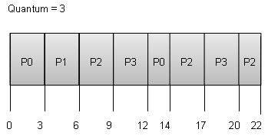
Operating System Presentation
Operating System Scheduling Algorithm:-
Round Robin Scheduling Algorithm:-

Slide 48
Operating System Presentation
Operating System Scheduling Algorithm:-
Round Robin Scheduling Algorithm:- Wait time of each process is as follows −
Average Wait Time: (9+2+12+11) / 4 = 8.5
Process | Wait Time : Service Time - Arrival Time
P0 | (0 - 0) + (12 - 3) = 9
P1 | (3 - 1) = 2
P2 | (6 - 2) + (14 - 9) + (20 - 17) = 12
P3 | (9 - 3) + (17 - 12) = 11

Slide 49
Operating System Presentation
Thread:- A thread is a flow of execution through the process code, with its own program counter that keeps track of which instruction to execute next, system registers which hold its current working variables, and a stack which contains the execution history.
A thread is also called a lightweight process. Threads provide a way to improve application performance through parallelism. Threads represent a software approach to improving performance of operating system by reducing the overhead thread is equivalent to a classical process.

Slide 50
Operating System Presentation
Advantages of Thread:- Threads minimize the context switching time.
Use of threads provides concurrency within a process.
Efficient communication.
It is more economical to create and context switch threads.
Threads allow utilization of multiprocessor architectures to a greater scale and efficiency.

Slide 51
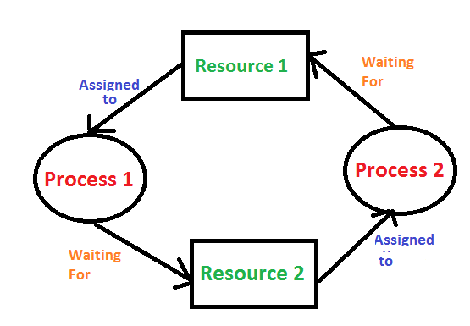
Operating System Presentation
Deadlock:- A Deadlock is a situation where each of the computer process waits for a resource which is being assigned to some another process. In this situation, none of the process gets executed since the resource it needs, is held by some other process which is also waiting for some other resource to be released.
Let us assume that there are three processes P1, P2 and P3. There are three different resources R1, R2 and R3. R1 is assigned to P1, R2 is assigned to P2 and R3 is assigned to P3.
After some time, P1 demands for R1 which is being used by P2. P1 halts its execution since it can't complete without R2. P2 also demands for R3 which is being used by P3. P2 also stops its execution because it can't continue without R3. P3 also demands for R1 which is being used by P1 therefore P3 also stops its execution.
.

Slide 52
Operating System Presentation
Necessary condition for Deadlock:-
Mutual Exclusion
A resource can only be shared in mutually exclusive manner. It implies, if two process cannot use the same resource at the same time.
Hold and Wait
A process waits for some resources while holding another resource at the same time.
No preemption
The process which once scheduled will be executed till the completion. No other process can be scheduled by the scheduler meanwhile.
Circular Wait
All the processes must be waiting for the resources in a cyclic manner so that the last process is waiting for the resource which is being held by the first process.
.

Slide 53
Operating System Presentation
Strategies for handling Deadlock:-
Deadlock Ignorance
Deadlock Prevention
Deadlock Avoidance
Deadlock Detection and Recovery.

Slide 54
Operating System Presentation
Strategies for handling Deadlock:-
Deadlock Prevention:- If we simulate deadlock with a table which is standing on its four legs then we can also simulate four legs with the four conditions which when occurs simultaneously, cause the deadlock.
However, if we break one of the legs of the table then the table will fall definitely. The same happens with deadlock, if we can be able to violate one of the four necessary conditions and don't let them occur together then we can prevent the deadlock.
The four conditions are
Mutual Exclusion
Hold and Wait
No Preeemption
Circular Wait

Slide 55
Operating System Presentation
Strategies for handling Deadlock:-
Deadlock Avoidance:- In deadlock avoidance, the request for any resource will be granted if the resulting state of the system doesn't cause deadlock in the system. The state of the system will continuously be checked for safe and unsafe states.
In order to avoid deadlocks, the process must tell OS, the maximum number of resources a process can request to complete its execution.
The simplest and most useful approach states that the process should declare the maximum number of resources of each type it may ever need. The Deadlock avoidance algorithm examines the resource allocations so that there can never be a circular wait condition.
Safe and Unsafe States
The resource allocation state of a system can be defined by the instances of available and allocated resources, and the maximum instance of the resources demanded by the processes.

Slide 56
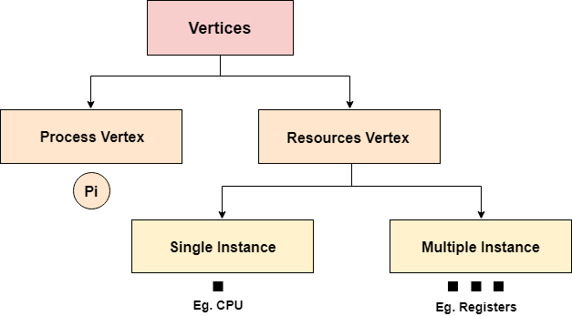
Operating System Presentation
Strategies for handling Deadlock:-
Resource Allocation Graph:- The resource allocation graph is the pictorial representation of the state of a system. As its name suggests, the resource allocation graph is the complete information about all the processes which are holding some resources or waiting for some resources.
It also contains the information about all the instances of all the resources whether they are available or being used by the processes.

Slide 57
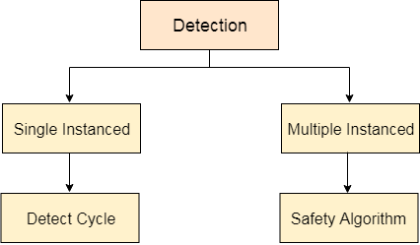
Operating System Presentation
Deadlock Detection and Recovery:-
In this approach, The OS doesn't apply any mechanism to avoid or prevent the deadlocks. Therefore the system considers that the deadlock will definitely occur. In order to get rid of deadlocks, The OS periodically checks the system for any deadlock. In case, it finds any of the deadlock then the OS will recover the system using some recovery techniques.

Slide 58
Operating System Presentation
Synchronization:-
When two or more process cooperates with each other, their order of execution must be preserved otherwise there can be conflicts in their execution and inappropriate outputs can be produced.
A cooperative process is the one which can affect the execution of other process or can be affected by the execution of other process. Such processes need to be synchronized so that their order of execution can be guaranteed.

Slide 59
Operating System Presentation
Synchronization:-
The procedure involved in preserving the appropriate order of execution of cooperative processes is known as Process Synchronization. There are various synchronization mechanisms that are used to synchronize the processes.
Race Condition:- A Race Condition typically occurs when two or more threads try to read, write and possibly make the decisions based on the memory that they are accessing concurrently.
Critical Section:- The regions of a program that try to access shared resources and may cause race conditions are called critical section. To avoid race condition among the processes, we need to assure that only one process at a time can execute within the critical section.

Slide 60
Operating System Presentation
Critical Section Problem:-
Critical Section is the part of a program which tries to access shared resources. That resource may be any resource in a computer like a memory location, Data structure, CPU or any IO device.
The critical section cannot be executed by more than one process at the same time; operating system faces the difficulties in allowing and disallowing the processes from entering the critical section.
The critical section problem is used to design a set of protocols which can ensure that the Race condition among the processes will never arise.

Slide 61
Operating System Presentation
Requirement of Synchronization Mechanism:-
Primary:-
Mutual Exclusion:- Our solution must provide mutual exclusion. By Mutual Exclusion, we mean that if one process is executing inside critical section then the other process must not enter in the critical section.
Progress:- Progress means that if one process doesn't need to execute into critical section then it should not stop other processes to get into the critical section.

Slide 62
Operating System Presentation
Requirement of Synchronization Mechanism:-
Secondary:-
Bounded Waiting
We should be able to predict the waiting time for every process to get into the critical section. The process must not be endlessly waiting for getting into the critical section.
Architectural Neutrality
Our mechanism must be architectural natural. It means that if our solution is working fine on one architecture then it should also run on the other ones as well.

Slide 63
Operating System Presentation
Lock Variable:- This is the simplest synchronization mechanism. This is a Software Mechanism implemented in User mode. This is a busy waiting solution which can be used for more than two processes.
In this mechanism, a Lock variable lock is used. Two values of lock can be possible, either 0 or 1. Lock value 0 means that the critical section is vacant while the lock value 1 means that it is occupied.
A process which wants to get into the critical section first checks the value of the lock variable. If it is 0 then it sets the value of lock as 1 and enters into the critical section, otherwise it waits.
The pseudo code of the mechanism looks like following.
Entry Section →
While (lock! = 0);
Lock = 1;
//Critical Section
Exit Section →
Lock =0;

Slide 64
Operating System Presentation
Lock Variable:- Initially the value of lock variable is 0. The process which needs to get into the critical section, enters into the entry section and checks the condition provided in the while loop.
The process will wait infinitely until the value of lock is 1 (that is implied by while loop). Since, at the very first time critical section is vacant hence the process will enter the critical section by setting the lock variable as 1.
When the process exits from the critical section, then in the exit section, it reassigns the value of lock as 0.
Every Synchronization mechanism is judged on the basis of four conditions.
Mutual Exclusion
Progress
Bounded Waiting
Portability
Out of the four parameters, Mutual Exclusion and Progress must be provided by any solution. Let’s analyze this mechanism on the basis of the above mentioned conditions.

Slide 65
Operating System Presentation
TLS Set Lock Mechanism:-
Modification in the assembly code:-
In lock variable mechanism, Sometimes Process reads the old value of lock variable and enters the critical section. Due to this reason, more than one process might get into critical section. However, the code shown in the part one of the following section can be replaced with the code shown in the part two. This doesn't affect the algorithm but, by doing this, we can manage to provide the mutual exclusion to some extent but not completely.

Slide 66
Operating System Presentation
TLS Instruction:-
Modification in the assembly code:-
However, the solution provided in the above segment provides mutual exclusion to some extent but it doesn't make sure that the mutual exclusion will always be there. There is a possibility of having more than one process in the critical section.
What if the process gets preempted just after executing the first instruction of the assembly code written in section 2? In that case, it will carry the old value of lock variable with it and it will enter into the critical section regardless of knowing the current value of lock variable. This may make the two processes present in the critical section at the same time.
To get rid of this problem, we have to make sure that the preemption must not take place just after loading the previous value of lock variable and before setting it to 1. The problem can be solved if we can be able to merge the first two instructions.

Slide 67
Operating System Presentation
TLS Instruction:-
Let's examine TSL on the basis of the four conditions.
Mutual Exclusion:- Mutual Exclusion is guaranteed in TSL mechanism since a process can never be preempted just before setting the lock variable. Only one process can see the lock variable as 0 at a particular time and that's why, the mutual exclusion is guaranteed.
Progress:- According to the definition of the progress, a process which doesn't want to enter in the critical section should not stop other processes to get into it. In TSL mechanism, a process will execute the TSL instruction only when it wants to get into the critical section. The value of the lock will always be 0 if no process doesn't want to enter into the critical section hence the progress is always guaranteed in TSL.
Bounded Waiting:- Bounded Waiting is not guaranteed in TSL. Some process might not get a chance for so long. We cannot predict for a process that it will definitely get a chance to enter in critical section after a certain time.
Architectural Neutrality:- TSL doesn't provide Architectural Neutrality. It depends on the hardware platform. The TSL instruction is provided by the operating system. Some platforms might not provide that. Hence it is not Architectural natural.

Slide 68
Operating System Presentation
TLS Instruction:-
Let's examine TSL on the basis of the four conditions.
Mutual Exclusion:- Mutual Exclusion is guaranteed in TSL mechanism since a process can never be preempted just before setting the lock variable. Only one process can see the lock variable as 0 at a particular time and that's why, the mutual exclusion is guaranteed.
Progress:- According to the definition of the progress, a process which doesn't want to enter in the critical section should not stop other processes to get into it. In TSL mechanism, a process will execute the TSL instruction only when it wants to get into the critical section. The value of the lock will always be 0 if no process doesn't want to enter into the critical section hence the progress is always guaranteed in TSL.
Bounded Waiting:- Bounded Waiting is not guaranteed in TSL. Some process might not get a chance for so long. We cannot predict for a process that it will definitely get a chance to enter in critical section after a certain time.
Architectural Neutrality:- TSL doesn't provide Architectural Neutrality. It depends on the hardware platform. The TSL instruction is provided by the operating system. Some platforms might not provide that. Hence it is not Architectural natural.

Slide 69
Operating System Presentation
Sleep and Wait(Pseudo Consumer Problem):-
Let's examine the basic model that is sleep and wake. Assume that we have two system calls as sleep and wake. The process which calls sleep will get blocked while the process which calls will get waked up.
There is a popular example called producer consumer problem which is the most popular problem simulating sleep and wake mechanism.
The concept of sleep and wake is very simple. If the critical section is not empty then the process will go and sleep. It will be waked up by the other process which is currently executing inside the critical section so that the process can get inside the critical section.
In producer consumer problem, let us say there are two processes, one process writes something while the other process reads that. The process which is writing something is called producer while the process which is reading is called consumer.

Slide 70
Operating System Presentation
Semaphore:- To get rid of the problem of wasting the wake-up signals, Dijkstra proposed an approach which involves storing all the wake-up calls. Dijkstra states that, instead of giving the wake-up calls directly to the consumer, producer can store the wake-up call in a variable. Any of the consumers can read it whenever it needs to do so.
Semaphore is the variables which stores the entire wake up calls that are being transferred from producer to consumer. It is a variable on which read, modify and update happens automatically in kernel mode.
Semaphore cannot be implemented in the user mode because race condition may always arise when two or more processes try to access the variable simultaneously. It always needs support from the operating system to be implemented.
According to the demand of the situation, Semaphore can be divided into two categories.
Counting Semaphore
Binary Semaphore or Mutex

Slide 71
Operating System Presentation
Binary Semaphore or Mutex:- In counting semaphore, Mutual exclusion was not provided because we has the set of processes which required to execute in the critical section simultaneously.
However, Binary Semaphore strictly provides mutual exclusion. Here, instead of having more than 1 slots available in the critical section, we can only have at most 1 process in the critical section. The semaphore can have only two values, 0 or 1.

Slide 72
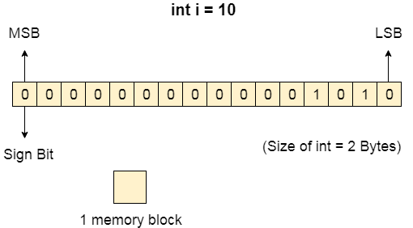
Operating System Presentation
Memory Management:- Computer memory can be defined as a collection of some data represented in the binary format. On the basis of various functions, memory can be classified into various categories.
How Data is being stored in a computer system?
In order to understand memory management, we have to make everything clear about how data is being stored in a computer system.
Machine understands only binary language that is 0 or 1. Computer converts every data into binary language first and then stores it into the memory.
That means if we have a program line written as int α = 10 then the computer converts it into the binary language and then store it into the memory blocks.
The representation of inti = 10 is shown below.

Slide 73
Operating System Presentation
Need for Multiprogramming:- The CPU can directly access the main memory, Registers and cache of the system. The program always executes in main memory. The size of main memory affects degree of Multi programming to most of the extant. If the size of the main memory is larger than CPU can load more processes in the main memory at the same time and therefore will increase degree of Multi programming as well as CPU utilization.

Slide 74
Operating System Presentation
Fixed Partitioning:- The earliest and one of the simplest technique which can be used to load more than one processes into the main memory is Fixed partitioning or Contiguous memory allocation.
In this technique, the main memory is divided into partitions of equal or different sizes. The operating system always resides in the first partition while the other partitions can be used to store user processes. The memory is assigned to the processes in contiguous way.
In fixed partitioning,
The partitions cannot overlap.
A process must be contiguously present in a partition for the execution.

Slide 75
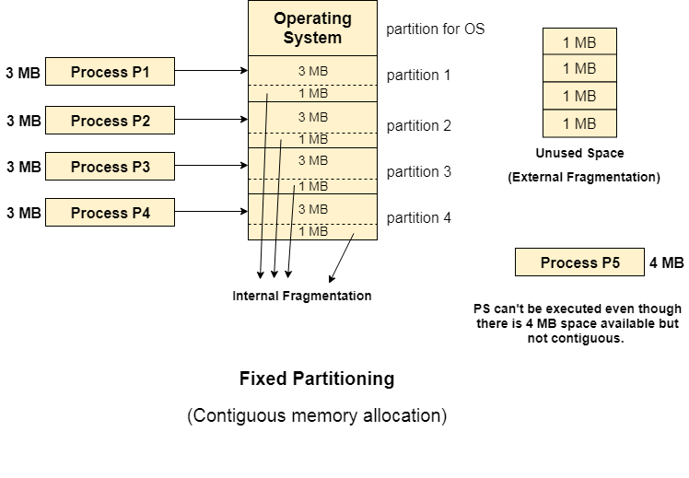
Operating System Presentation
Fixed Partitioning:-

Slide 76
Operating System Presentation
Fixed Partitioning:- There are various cons of this technique. They are:
Internal Fragmentation
External Fragmentation
Limitation on the size of the process
Degree of Multiprogramming is less

Slide 77
Operating System Presentation
Dynamic Partitioning:- Dynamic partitioning tries to overcome the problems caused by fixed partitioning. In this technique, the partition size is not declared initially. It is declared at the time of process loading.
The first partition is reserved for the operating system. The remaining space is divided into parts. The size of each partition will be equal to the size of the process. The partition size varies according to the need of the process so that the internal fragmentation can be avoided.

Slide 78
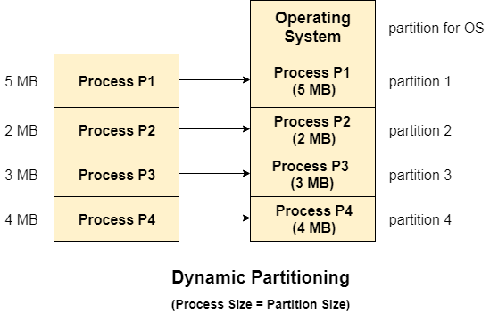
Operating System Presentation
Dynamic Partitioning:-

Slide 79
Operating System Presentation
Advantages of Dynamic Partitioning over Fixed Partitioning:-
1. No Internal Fragmentation:- Given the fact that the partitions in dynamic partitioning are created according to the need of the process, It is clear that there will not be any internal fragmentation because there will not be any unused remaining space in the partition.
2. No Limitation on the size of the process:- In Fixed partitioning, the process with the size greater than the size of the largest partition could not be executed due to the lack of sufficient contiguous memory. Here, In Dynamic partitioning, the process size can't be restricted since the partition size is decided according to the process size.
3. Degree of multiprogramming is dynamic:- Due to the absence of internal fragmentation, there will not be any unused space in the partition hence more processes can be loaded in the memory at the same time.

Slide 80
Operating System Presentation
Disadvantages of Dynamic Partitioning:-
External Fragmentation
Complex Memory Allocation

Slide 81
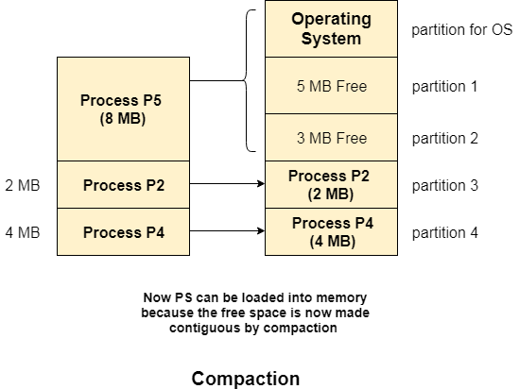
Operating System Presentation
Compaction:- We got to know that the dynamic partitioning suffers from external fragmentation. However, this can cause some serious problems.
To avoid compaction, we need to change the rule which says that the process can't be stored in the different places in the memory.

Slide 82
Operating System Presentation
Bitmap for Dynamic Partitioning:- We got to know that the dynamic partitioning suffers from external fragmentation. However, this can cause some serious problems.
To avoid compaction, we need to change the rule which says that the process can't be stored in the different places in the memory.

Slide 83
Operating System Presentation
Bitmap for Dynamic Partitioning:- The main task of the operating system is to keep track of whether the partition is free or filled. For this purpose, the operating system also manages another data structure that is called bitmap.
The process or the hole in Allocation units is represented by a flag bit of bitmap. In the image shown below, a flag bit is defined for every bit of allocation units. However, it is not the general case, it depends on the OS that, for how many bits of the allocation units, it wants to store the flag bit.
The flag bit is set to 1 if there is a contiguously present process at the adjacent bit in allocation unit otherwise it is set to 0.

Slide 84
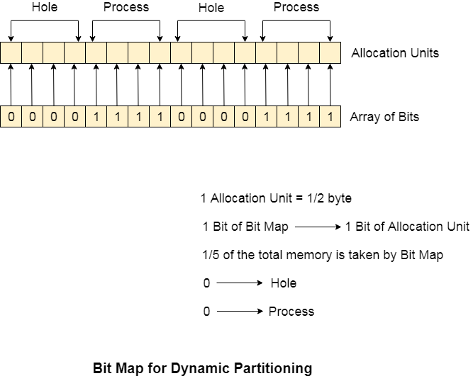
Operating System Presentation
Bitmap for Dynamic Partitioning:-

Slide 85
Operating System Presentation
Linked List for Dynamic Partitioning:- The better and the most popular approach to keep track the free or filled partitions is using Linked List.
In this approach, the Operating system maintains a linked list where each node represents each partition. Every node has three fields.
First field of the node stores a flag bit which shows whether the partition is a hole or some process is inside.
Second field stores the starting index of the partition.
Third filed stores the end index of the partition.
If a partition is freed at some point of time then that partition will be merged with its adjacent free partition without doing any extra effort.

Slide 86
Operating System Presentation
Linked List for Dynamic Partitioning:- There are some points which need to be focused while using this approach.
The OS must be very clear about the location of the new node which is to be added in the linked list. However, adding the node according to the increasing order of starting index is suggestible.
Using a doubly linked list will make some positive effects on the performance due to the fact that a node in the doubly link list can also keep track of its previous node.

Slide 87
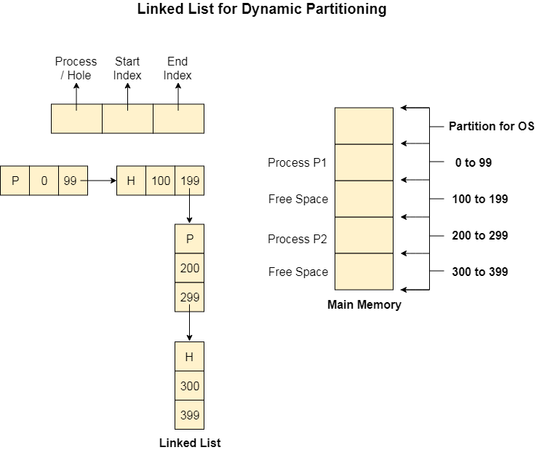
Operating System Presentation
Linked List for Dynamic Partitioning:-

Slide 88
Operating System Presentation
Partitioning Algorithm:- There are various algorithms which are implemented by the Operating System in order to find out the holes in the linked list and allocate them to the processes. They are
First Fit
Next Fit
Best Fit
Worst Fit
Quick Fit

Slide 89
Operating System Presentation
Partitioning Algorithm:-
First Fit:- First Fit algorithm scans the linked list and whenever it finds the first big enough hole to store a process, it stops scanning and load the process into that hole. This procedure produces two partitions. Out of them, one partition will be a hole while the other partition will store the process.
First Fit algorithm maintains the linked list according to the increasing order of starting index. This is the simplest to implement among all the algorithms and produces bigger holes as compare to the other algorithms.

Slide 90
Operating System Presentation
Partitioning Algorithm:-
2. Next Fit:- Next Fit algorithm is similar to First Fit algorithm except the fact that, Next fit scans the linked list from the node where it previously allocated a hole.
Next fit doesn't scan the whole list, it starts scanning the list from the next node. The idea behind the next fit is the fact that the list has been scanned once therefore the probability of finding the hole is larger in the remaining part of the list.

Slide 91
Operating System Presentation
Partitioning Algorithm:-
3. Best Fit:- The Best Fit algorithm tries to find out the smallest hole possible in the list that can accommodate the size requirement of the process.
Using Best Fit has some disadvantages.
1. It is slower because it scans the entire list every time and tries to find out the smallest hole which can satisfy the requirement the process.
Due to the fact that the difference between the whole size and the process size is very small, the holes produced will be as small as it cannot be used to load any process and therefore it remains useless. Despite of the fact that the name of the algorithm is best fit, It is not the best algorithm among all.

Slide 92
Operating System Presentation
Partitioning Algorithm:-
4. Worst Fit:- The worst fit algorithm scans the entire list every time and tries to find out the biggest hole in the list which can fulfill the requirement of the process.
Despite of the fact that this algorithm produces the larger holes to load the other processes, this is not the better approach due to the fact that it is slower because it searches the entire list every time again and again.

Slide 93
Operating System Presentation
Partitioning Algorithm:-
5. Quick Fit:- The quick fit algorithm suggests maintaining the different lists of frequently used sizes. Although, it is not practically suggestible because the procedure takes so much time to create the different lists and then expending the holes to load a process.
The first fit algorithm is the best algorithm among all because
It takes lesser time compare to the other algorithms.
It produces bigger holes that can be used to load other processes later on.
It is easiest to implement.

Slide 94
Operating System Presentation
Need for Paging:-
Disadvantages of Dynamic Partitioning:- The main disadvantage of Dynamic Partitioning is External fragmentation. Although, this can be removed by Compaction but as we have discussed earlier, the compaction makes the system inefficient.

Slide 95
Operating System Presentation
Need for Paging:-
Need for Paging:- Lets consider a process P1 of size 2 MB and the main memory which is divided into three partitions. Out of the three partitions, two partitions are holes of size 1 MB each.
P1 needs 2 MB space in the main memory to be loaded. We have two holes of 1 MB each but they are not contiguous.
Although, there is 2 MB space available in the main memory in the form of those holes but that remains useless until it become contiguous. This is a serious problem to address.
We need to have some kind of mechanism which can store one process at different locations of the memory.
The Idea behind paging is to divide the process in pages so that, we can store them in the memory at different holes. We will discuss paging with the examples in the next sections.

Slide 96
Operating System Presentation
Paging With Example:-
In Operating Systems, Paging is a storage mechanism used to retrieve processes from the secondary storage into the main memory in the form of pages.
The main idea behind the paging is to divide each process in the form of pages. The main memory will also be divided in the form of frames.
One page of the process is to be stored in one of the frames of the memory. The pages can be stored at the different locations of the memory but the priority is always to find the contiguous frames or holes.
Pages of the process are brought into the main memory only when they are required otherwise they reside in the secondary storage.
Different operating system defines different frame sizes. The sizes of each frame must be equal. Considering the fact that the pages are mapped to the frames in Paging, page size needs to be as same as frame size.

Slide 97
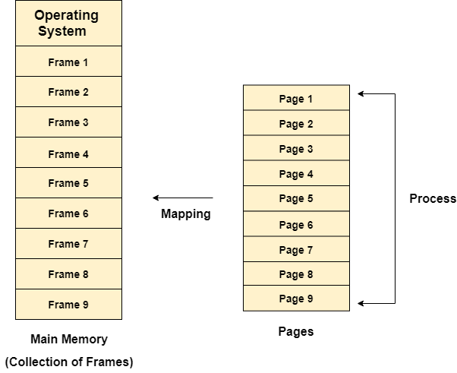
Operating System Presentation
Paging:-

Slide 98
Operating System Presentation
Basics of Binary Address:-
Computer system assigns the binary addresses to the memory locations. However, The system uses amount of bits to address a memory location.
Using 1 bit, we can address two memory locations. Using 2 bits we can address 4 and using 3 bits we can address 8 memory locations.
A pattern can be identified in the mapping between the number of bits in the address and the range of the memory locations.

Slide 99
Operating System Presentation
Basics of Binary Address:-
We know,
Using 1 Bit we can represent 2^1 i.e 2 memory locations.
Using 2 bits, we can represent 2^2 i.e. 4 memory locations.
Using 3 bits, we can represent 2^3 i.e. 8 memory locations.
Therefore, if we generalize this,
Using n bits, we can assign 2^n memory locations.
n bits of address → 2 ^ n memory locations

Slide 100
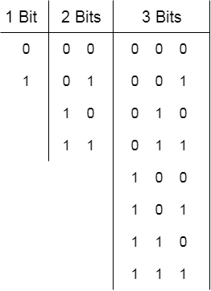
Operating System Presentation
Basics of Binary Address:-

Slide 101
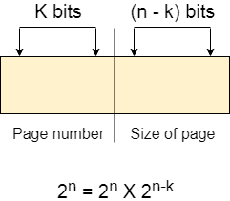
Operating System Presentation
Basics of Binary Address:- these n bits can be divided into two parts, that are, K bits and (n-k) bits.

Slide 102
Operating System Presentation
Page Table:- Page Table is a data structure used by the virtual memory system to store the mapping between logical addresses and physical addresses.
Logical addresses are generated by the CPU for the pages of the processes therefore they are generally used by the processes.
Physical addresses are the actual frame address of the memory. They are generally used by the hardware or more specifically by RAM subsystems.
Given Images can be considered as follows:
Physical Address Space = M words Logical Address Space = L words Page Size = P words Physical Address = log ₂ M = m bits Logical Address = log ₂ L = l bits page offset = log ₂ P = p bits

Slide 103
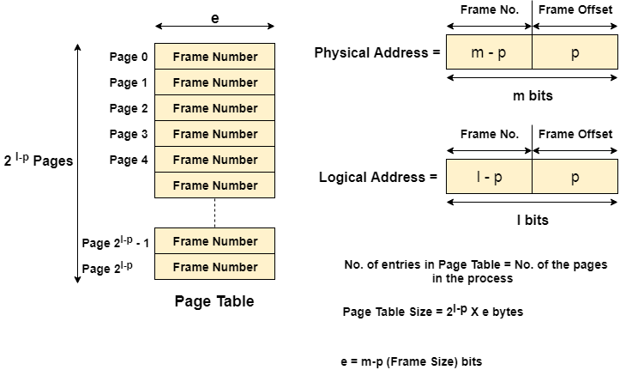
Operating System Presentation
Page Table:-

Slide 104
Operating System Presentation
Page Table:- The CPU always accesses the processes through their logical addresses. However, the main memory recognizes physical address only.
In this situation, a unit named as Memory Management Unit comes into the picture. It converts the page number of the logical address to the frame number of the physical address. The offset remains same in both the addresses.
To perform this task, Memory Management unit needs a special kind of mapping which is done by page table. The page table stores all the Frame numbers corresponding to the page numbers of the page table.
In other words, the page table maps the page number to its actual location (frame number) in the memory.
In the image given below shows, how the required word of the frame is accessed with the help of offset.

Slide 105
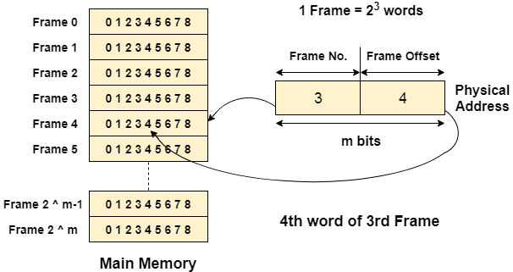
Operating System Presentation
Page Table:-

Slide 106
Operating System Presentation
Mapping From Page Table to main memory:- In operating systems, there is always a requirement of mapping from logical address to the physical address. However, this process involves various steps which are defined as follows.
Generation of Logical Address
Scaling
Generation of Physical Address
Getting actual frame number

Slide 107
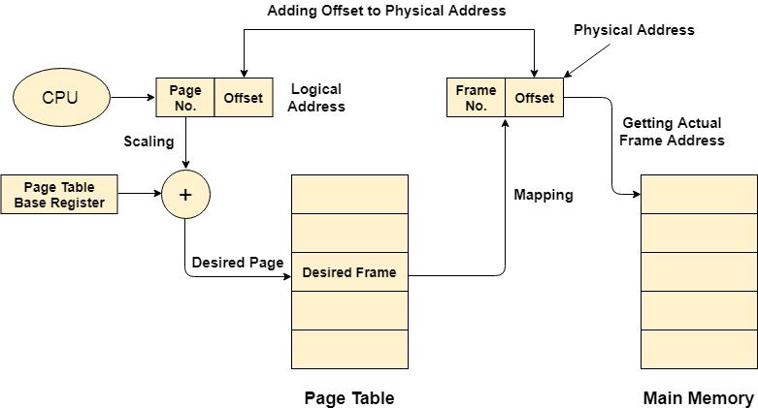
Operating System Presentation
Mapping From Page Table to main memory:-

Slide 108
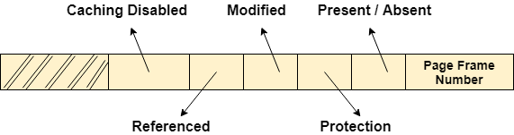
Operating System Presentation
Page Table Entry:- Along with page frame number, the page table also contains some of the bits representing the extra information regarding the page.
Caching disabled
Referenced
Modified
Protection
Present / Absent

Slide 109
Operating System Presentation
Page Table Size:- The size of the page table depends upon the number of entries in the table and the bytes stored in one entry.
Let's consider,
Logical Address = 24 bits
Logical Address space = 2 ^ 24 bytes
Let's say, Page size = 4 KB = 2 ^ 12 Bytes
Page offset = 12
Number of bits in a page = Logical Address - Page Offset = 24 - 12 = 12 bits
Number of pages = 2 ^ 12 = 2 X 2 X 10 ^ 10 = 4 KB
Let's say, Page table entry = 1 Byte
Therefore, the size of the page table = 4 KB X 1 Byte = 4 KB

Slide 110
Operating System Presentation
Page Table Size:- The size of the page table depends upon the number of entries in the table and the bytes stored in one entry.
Let's consider,
Logical Address = 24 bits
Logical Address space = 2 ^ 24 bytes
Let's say, Page size = 4 KB = 2 ^ 12 Bytes
Page offset = 12
Number of bits in a page = Logical Address - Page Offset = 24 - 12 = 12 bits
Number of pages = 2 ^ 12 = 2 X 2 X 10 ^ 10 = 4 KB
Let's say, Page table entry = 1 Byte
Therefore, the size of the page table = 4 KB X 1 Byte = 4 KB

Slide 111
Operating System Presentation
Virtual Memory:- Virtual Memory is a storage scheme that provides user an illusion of having a very big main memory. This is done by treating a part of secondary memory as the main memory.
In this scheme, User can load the bigger size processes than the available main memory by having the illusion that the memory is available to load the process.
Instead of loading one big process in the main memory, the Operating System loads the different parts of more than one process in the main memory.

Slide 112
Operating System Presentation
Virtual Memory Working Procedure:- In modern word, virtual memory has become quite common these days. In this scheme, whenever some pages needs to be loaded in the main memory for the execution and the memory is not available for those many pages, then in that case, instead of stopping the pages from entering in the main memory, the OS search for the RAM area that are least used in the recent times or that are not referenced and copy that into the secondary memory to make the space for the new pages in the main memory.
Since all this procedure happens automatically, therefore it makes the computer feel like it is having the unlimited RAM.

Slide 113
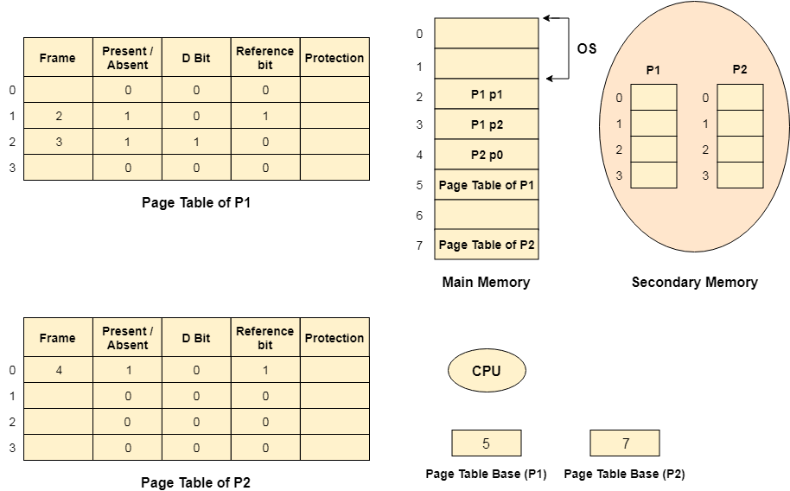
Operating System Presentation
Virtual Memory:-

Slide 114
Operating System Presentation
Demand Paging:- Demand Paging is a popular method of virtual memory management. In demand paging, the pages of a process which are least used, get stored in the secondary memory.
A page is copied to the main memory when its demand is made or page fault occurs. There are various page replacement algorithms which are used to determine the pages which will be replaced. We will discuss each one of them later in detail.

Slide 115
Operating System Presentation
Advantages of Virtual Memory System:-
The degree of Multiprogramming will be increased.
User can run large application with less real RAM.
There is no need to buy more memory RAMs.

Slide 116
Operating System Presentation
Disadvantages of Virtual Memory System:-
The system becomes slower since swapping takes time.
It takes more time in switching between applications.
The user will have the lesser hard disk space for its use.

Slide 117
Operating System Presentation
Drawbacks of Paging:-
Size of Page table can be very big and therefore it wastes main memory.
CPU will take more time to read a single word from the main memory.

Slide 118
Operating System Presentation
Locality of Reference:-
In operating systems, the concept of locality of reference states that, instead of loading the entire process in the main memory, OS can load only those number of pages in the main memory that are frequently accessed by the CPU and along with that, the OS can also load only those page table entries which are corresponding to those many pages.

Slide 119
Operating System Presentation
Translation Lookaside Buffer(TLB):-
A Translation look aside buffer can be defined as a memory cache which can be used to reduce the time taken to access the page table again and again.
It is a memory cache which is closer to the CPU and the time taken by CPU to access TLB is lesser then that taken to access main memory.
In other words, we can say that TLB is faster and smaller than the main memory but cheaper and bigger than the register.
TLB follows the concept of locality of reference which means that it contains only the entries of those many pages that are frequently accessed by the CPU.

Slide 120
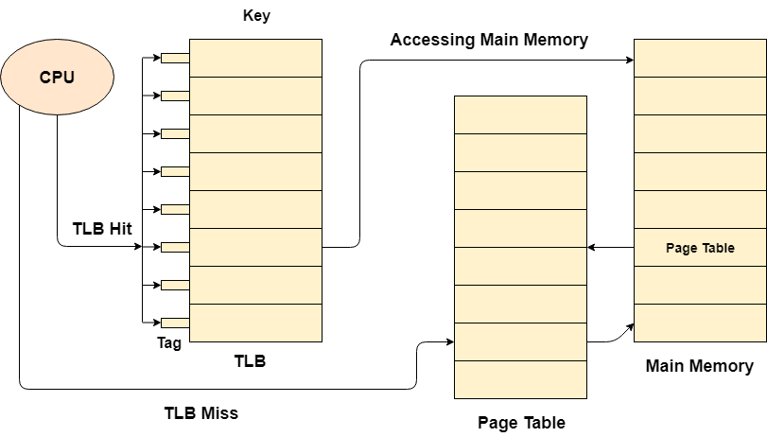
Operating System Presentation
Translation Lookaside Buffer(TLB):-

Slide 121
Operating System Presentation
Demand Paging:- According to the concept of Virtual Memory, in order to execute some process, only a part of the process needs to be present in the main memory which means that only a few pages will only be present in the main memory at any time.
However, deciding, which pages need to be kept in the main memory and which need to be kept in the secondary memory, is going to be difficult because we cannot say in advance that a process will require a particular page at particular time.
Therefore, to overcome this problem, there is a concept called Demand Paging is introduced. It suggests keeping all pages of the frames in the secondary memory until they are required. In other words, it says that do not load any page in the main memory until it is required.
Whenever any page is referred for the first time in the main memory, then that page will be found in the secondary memory.
After that, it may or may not be present in the main memory depending upon the page replacement algorithm which will be covered later in this tutorial.

Slide 122
Operating System Presentation
Page Fault:- If the referred page is not present in the main memory then there will be a miss and the concept is called Page miss or page fault.
The CPU has to access the missed page from the secondary memory. If the number of page fault is very high then the effective access time of the system will become very high.

Slide 123
Operating System Presentation
Thrashing:- If the number of page faults is equal to the number of referred pages or the number of page faults are so high so that the CPU remains busy in just reading the pages from the secondary memory then the effective access time will be the time taken by the CPU to read one word from the secondary memory and it will be so high. The concept is called thrashing.
If the page fault rate is PF %, the time taken in getting a page from the secondary memory and again restarting is S (service time) and the memory access time is ma then the effective access time can be given as;
EAT = PF X S + (1 - PF) X (ma)

Slide 124
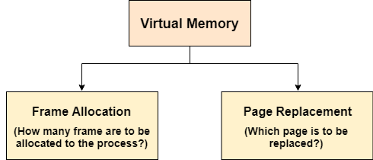
Operating System Presentation
Page Replacement Algorithms:- The page replacement algorithm decides which memory page is to be replaced. The process of replacement is sometimes called swap out or write to disk. Page replacement is done when the requested page is not found in the main memory (page fault).

Slide 125
Operating System Presentation
Types of Page Replacement Algorithms:- There are various page replacement algorithms. Each algorithm has a different method by which the pages can be replaced.
Optimal Page Replacement algorithm → this algorithms replaces the page which will not be referred for so long in future. Although it can not be practically implementable but it can be used as a benchmark. Other algorithms are compared to this in terms of optimality.
Least recent used (LRU) page replacement algorithm → this algorithm replaces the page which has not been referred for a long time. This algorithm is just opposite to the optimal page replacement algorithm. In this, we look at the past instead of staring at future.
FIFO → in this algorithm, a queue is maintained. The page which is assigned the frame first will be replaced first. In other words, the page which resides at the rare end of the queue will be replaced on the every page fault.

Slide 126
Operating System Presentation
Belady’s Anomaly:- In the case of LRU and optimal page replacement algorithms, it is seen that the number of page faults will be reduced if we increase the number of frames. However, Balady found that, In FIFO page replacement algorithm, the number of page faults will get increased with the increment in number of frames.

Slide 127
Operating System Presentation
Segmentation:- In Operating Systems, Segmentation is a memory management technique in which, the memory is divided into the variable size parts. Each part is known as segment which can be allocated to a process.
The details about each segment are stored in a table called as segment table. Segment table is stored in one (or many) of the segments.
Segment table contains mainly two information about segment:
Base: It is the base address of the segment
Limit: It is the length of the segment.

Slide 128
Operating System Presentation
Requirement of Segmentation:- Till now, we were using Paging as our main memory management technique. Paging is more close to Operating system rather than the User. It divides all the process into the form of pages regardless of the fact that a process can have some relative parts of functions which needs to be loaded in the same page.
Operating system doesn't care about the User's view of the process. It may divide the same function into different pages and those pages may or may not be loaded at the same time into the memory. It decreases the efficiency of the system.
It is better to have segmentation which divides the process into the segments. Each segment contain same type of functions such as main function can be included in one segment and the library functions can be included in the other segment,

Slide 129
Operating System Presentation
Translation of Logical Address into Physical Address by Segment Table:-
CPU generates a logical address which contains two parts:
Segment Number
Offset
The Segment number is mapped to the segment table. The limit of the respective segment is compared with the offset. If the offset is less than the limit then the address is valid otherwise it throws an error as the address is invalid.
In the case of valid address, the base address of the segment is added to the offset to get the physical address of actual word in the main memory.

Slide 130
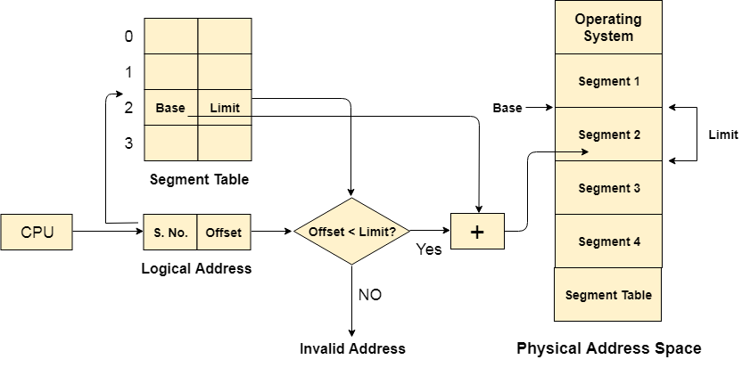
Operating System Presentation
Translation of Logical Address into Physical Address by Segment Table:-

Slide 131
Operating System Presentation
Advantages of Segmentation:- The Advantages of Segmentation are as follows:
No internal fragmentation
Average Segment Size is larger than the actual page size.
Less overhead
It is easier to relocate segments than entire address space.
The segment table is of lesser size as compare to the page table in paging.
Disadvantages of Segmentation:- It can have external fragmentation.
it is difficult to allocate contiguous memory to variable sized partition.
Costly memory management algorithms.

Slide 132
Operating System Presentation
Paging Vs Segmentation:-
Sr No. | Paging | Segmentation
1 | Non-Contiguous memory allocation | Non-contiguous memory allocation
2 | Paging divides program into fixed size pages. | Segmentation divides program into variable size segments.
3 | OS is responsible | Compiler is responsible.
4 | Paging is faster than segmentation | Segmentation is slower than paging
5 | Paging is closer to Operating System | Segmentation is closer to User
6 | It suffers from internal fragmentation | It suffers from external fragmentation
7 | There is no external fragmentation | There is no external fragmentation

Slide 133

Operating System Presentation
File Management System:- A file can be defined as a data structure which stores the sequence of records. Files are stored in a file system, which may exist on a disk or in the main memory. Files can be simple (plain text) or complex (specially-formatted).
The collection of files is known as Directory. The collection of directories at the different levels, is known as File System.

Slide 134
Operating System Presentation
Attributes of File Management System:-
1.Name
Every file carries a name by which the file is recognized in the file system. One directory cannot have two files with the same name.
2.Identifier
Along with the name, Each File has its own extension which identifies the type of the file. For example, a text file has the extension .txt, A video file can have the extension .mp4.
3.Type
In a File System, the Files are classified in different types such as video files, audio files, text files, executable files, etc.
4.Location
In the File System, there are several locations on which, the files can be stored. Each file carries its location as its attribute.

Slide 135
Operating System Presentation
Attributes of File Management System:-
5.Size
The Size of the File is one of its most important attribute. By size of the file, we mean the number of bytes acquired by the file in the memory.
6.Protection
The Admin of the computer may want the different protections for the different files. Therefore each file carries its own set of permissions to the different group of Users.
7.Time and Date
Every file carries a time stamp which contains the time and date on which the file is last modified.

Slide 136
Operating System Presentation
Attributes of File Management System:-
5.Size
The Size of the File is one of its most important attribute. By size of the file, we mean the number of bytes acquired by the file in the memory.
6.Protection
The Admin of the computer may want the different protections for the different files. Therefore each file carries its own set of permissions to the different group of Users.
7.Time and Date
Every file carries a time stamp which contains the time and date on which the file is last modified.

Slide 137
Thank You

